Slide 1
Image Management
LLD

Slide 2
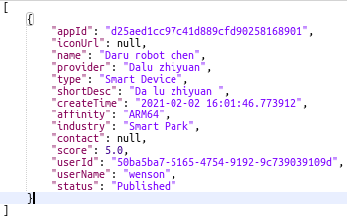
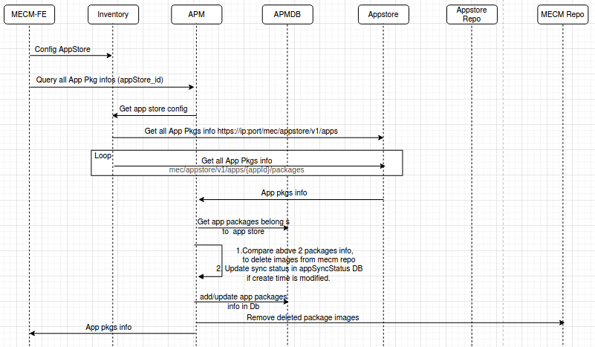

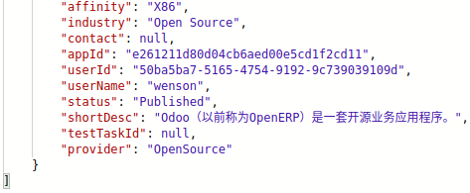
App Store get response
Query APP store packages info
GET: https://119.8.63.144:30099/mec/appstore/v1/apps
GET: https://119.8.63.144:30099/mec/appstore/v1/apps/e261211d80d04cb6aed00e5cd1f2cd11/packages
GET: https://119.8.63.144:30099/mec/appstore/v1/apps/e261211d80d04cb6aed00e5cd1f2cd11/packages/b5a6ca9b8f85477bba2cd66fd79d5f98
GET: https://119.8.63.144:30099/mec/appstore/v1/apps/{appId}/packages/{packageId}/action/download

Slide 3
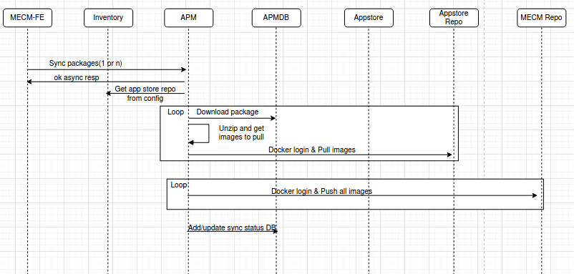
Sync docker images for the selected application packages
APP store url
GET: https://119.8.63.144:30099/mec/appstore/v1/apps/{appId}/packages/{packageId}/action/download

Slide 4
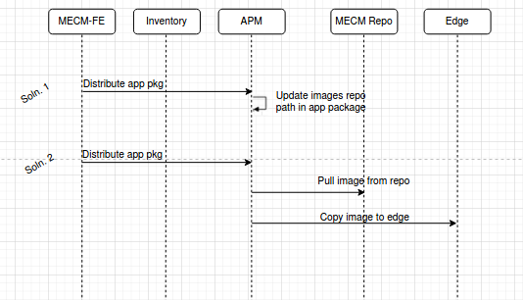

Distribute flow diagram
During app Instantiation docker images will be pulled from MECM repo.
In Edge, docker login to MECM repo is must, prior to app instantiation, this should be handled as part of edgegallery deployment ?
Stretch goal
Not tried this soln.

Slide 5
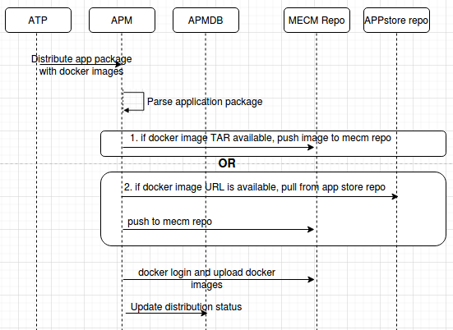
ATP Distribute/upload package to APM
Application package may contain
Docker image tar files
Image URLs
If docker images available, load those to mecm repo
If URL’s are available, pull from the app store and push images to mecm repo

Slide 6
Method | API | RequestBody | Response
POST | /inventory/v1/appstores | AppStoreDto | ok/error
PUT | /inventory/v1/appstores/{appstoreId} | AppStoreDto | ok/error
GET | /inventory/v1/appstores | none | AppStoreDtos
DELETE | /inventory/v1/appstores/{appstoreId} | none | ok/error
GET | /inventory/v1/appstores/{appstoreId} | none | AppStoreDtos
DELETE | /inventory/v1/appstores | none | ok/error
GET | apm/v1/apps/{app_id}/packages/{package_id}/syncstatus | none | AppPkgsSyncStatus
POST | /apm/v1/apps/syncstatus | AppPkgsSync | ok/error
GET | /apm/v1/apps/syncstatus | none | AppPkgsSyncStatus
POST | /apm/v1/apps/sync | AppPkgsSync | ok/error
GET | /apm/v1/apps/info/appstores/119.8.63.144 | none | AppPkgInfos

Slide 7
GET:https://{{mecmIp}}:30202/apm/v1/apps/info/appstores/119.8.63.144
CURD : https://{{mecmIp}}:30203/inventory/v1/appstores/
[
{
"packageId": "27a65d977a9e4e848db5368424025b4f",
"size": "0",
"affinity": "X86",
"industry": "Open Source",
"contact": null,
"appId": "e261211d80d04cb6aed00e5cd1f2cd11",
"userId": "50ba5ba7-5165-4754-9192-9c739039109d",
"userName": "wenson",
"status": "Published",
"shortDesc": "Odoo（以前称为OpenERP）是一套开源业务应用程序。",
"testTaskId": null,
"provider": "OpenSource"
}
]
Configure app store
Query App store
{
"appstoreName" : "appStoreName" ,
"appstoreIp" : "119.8.63.144" ,
"appstorePort" : "30099" ,
"appstoreRepoUserName" : "appstoreUsername",
"appstoreRepoPassword" : "appstore@123345678",
"producer": "AppProducer"
}
POST: https://{{mecmIp}}:30202/apm/v1/apps/sync
[{
"appstoreIp": "119.8.63.144",
"packageId": "b5a6ca9b8f85477bba2cd66fd79d5f98",
"appId": "e261211d80d04cb6aed00e5cd1f2cd11"
}
]
Sync app package
GET /apm/v1/apps/{app_id}/packages/{package_id}/syncstatus
GET: https://{{mecmIp}}:30202/apm/v1/apps/syncstatus
Query App package sync status
[
{
"appId": "bb1a5a2bcca346f68fec9d71682fb80f",
"packageId": "27a65d977a9e4e848db5368424025b4f",
"syncStatus": "SYNC_FAILED"
}
]
[
{
"appId": "e261211d80d04cb6aed00e5cd1f2cd11",
"packageId": "b5a6ca9b8f85477bba2cd66fd79d5f98",
"status": "accepted"
}
]

Slide 8
public final class AppPkgInfos {
private String packageId;
private String size;
private String createTime;
private String name;
private String version;
private String type;
private String affinity;
private String industry;
private String contact;
private String appId;
private String userId;
private String userName;
private String status;
private String shortDesc;
private String testTaskId;
private String provider;
}
public final class AppStoreDtos {
private List<AppStoreDto> appStoreDto;
}
public final class SyncAppPackageDto
{
private String appstoreIp;
private String packageId;
private String appId;
}
public final class AppStoreDto {
private String appstoreIp;
private String appstorePort;
private String appStoreRepoUserName;
private String appStoreRepoPassword;
}
public final class AppPkgsSyncStatus {
private String packageId;
private String appId;
private String status;
}

Slide 9
public final class MecHostDto {
private String mechostIp;
private String mechostName;
private String zipCode;
private String city;
private String address;
private String affinity;
private String userName;
private String edgerepoName;
private String edgerepoIp;
private String edgerepoPort;
private String edgerepoUsername;
private String applcmIp;
private String appRuleIp;
private String coordinates;
private Set<@Valid MecHwCapabilityDto> hwcapabilities = new LinkedHashSet<>();
}
[
{
"mechostIp": "string",
"mechostName": "string",
"zipCode": "string",
"city": "string",
"address": "string",
"affinity": "string",
"userName": "string",
"edgerepoName": null,
"edgerepoIp": "string",
"edgerepoPort": "string",
"edgerepoUsername": "string",
"applcmIp": "string",
"hwcapabilities": [
{
"hwType": "string",
"hwVendor": "string",
"hwModel": "string"
},
{
"hwType": "string",
"hwVendor": "string",
"hwModel": "string"
}
]
}
]
Will be removed

Slide 10
Open Questions

Slide 11
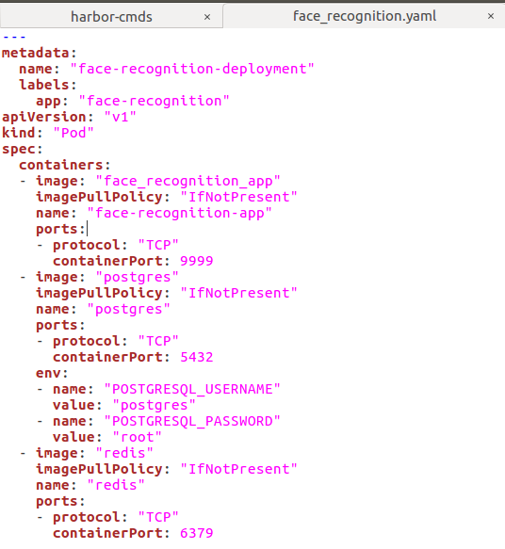
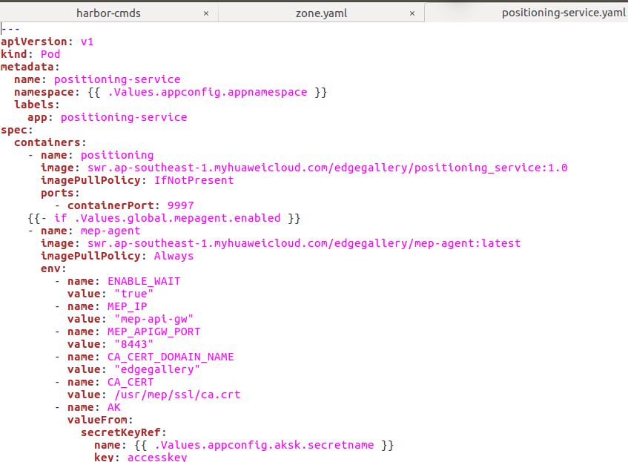
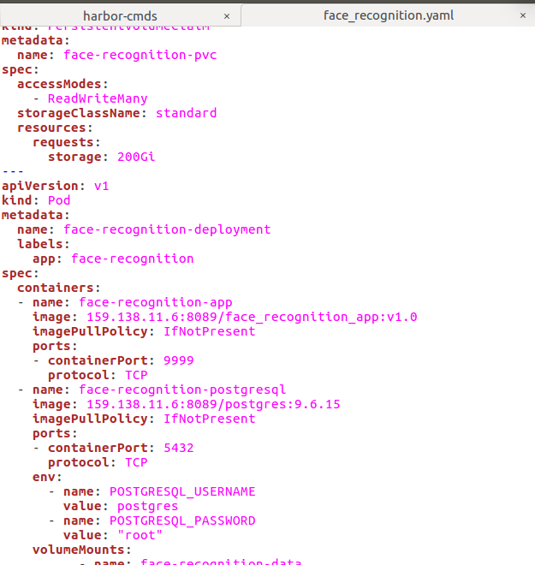
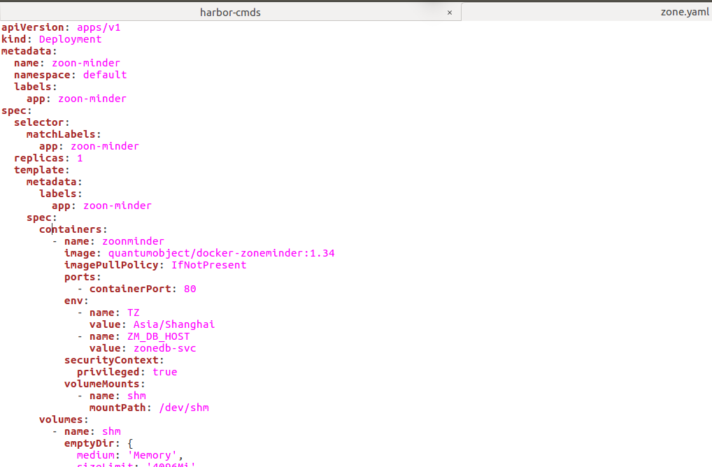
Can this be standardised to provide image name as part of values.yaml ?

Slide 12
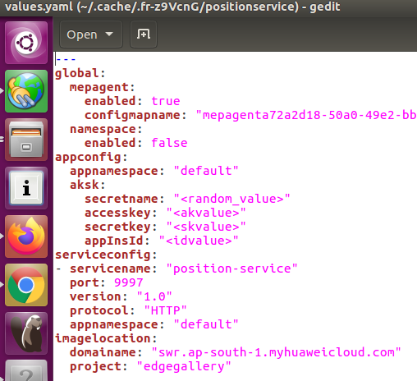
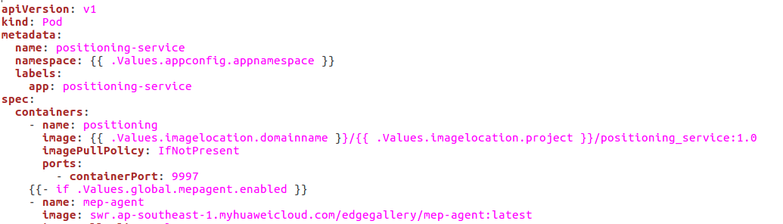
values yaml
Deployment yaml

Slide 13
2. Delete image in repo scenario:
How to delete docker images in MECM repo when image is used by some other application package
Possible soln: maintain count for docker image used by application packages.
3. mechanism to store app store repo password in DB:
How to get master key used to encrypt/decrypt app store repo password ←--(Store in plan test as per Arch community suggestion in v1.1)
4. mechanism to store MECM repo password in APM
APM communicate with MECM repo, how to get masterkey and password and how to store ? (Get as plan text as per Arch community suggestion in v1.1)
5. Edge will pull docker images from MECM repo during instantiation, Edge docker should be logged in to MECM repo prior to app instantiation, this should be done as part of edgegallery deployment using deployment scripts ?
6.EG Installation team has to install harbor repo and provide its end point to APM during deployment.

Slide 14
Thank you

Slide 15
BackUp Slides

Slide 16
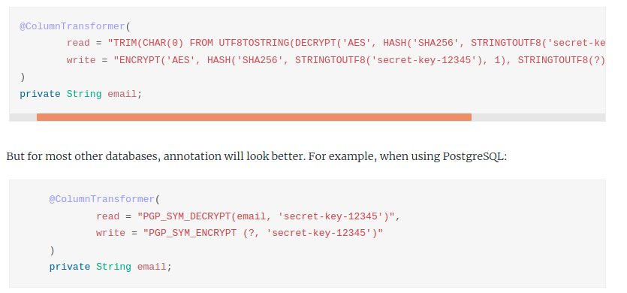
https://medium.com/faun/spring-boot-jpa-data-encryption-a8e7cacfa8e8
https://sultanov.dev/blog/database-column-level-encryption-with-spring-data-jpa/
https://sunitkatkar.blogspot.com/2018/04/spring-boot-2-generic-jpa-converter-to.html
https://vladmihalcea.com/how-to-encrypt-and-decrypt-data-with-hibernate/
https://www.baeldung.com/spring-boot-jasypt
https://www.geeksforgeeks.org/how-to-encrypt-passwords-in-a-spring-boot-project-using-jasypt/

